Slide 1
Amplitude Modulation

Slide 2
Chapter 2: Recap
1. Linear Time-invariant Systems (LTI)
2. Fourier Series representation of periodic signals
3. Fourier Transform representation
4. Energy and power signals. Parseval’s relationship
5. Bandwidth of a time limited signal
6. Baseband and Passband Signals
7. Complex Envelope of a passband signal

Slide 3
Example
Consider the tent signal s(t) = (1 − |t|)I[−1,1](t).
(a) Find and sketch the Fourier transform S(f).
(b) Compute the 99% energy containment bandwidth in KHz, assuming that the unit of time is milliseconds.

Slide 4
Example

Slide 5
Example

Slide 6
Example

Slide 7
Analog communication techniques: why?
Why bother?
After all, the world is going digital
Modern communication system designers focused mainly on DSP algorithms for digital communication.
But need to understand the underlying physical analog signals
Establishes common language with circuit designers
Analog-centric techniques become critical when pushing the limits of carrier frequency, bandwidth and/or power consumption
Focus of these techniques is on baseband to passband conversion, and back

Slide 8
Key concepts
Two ways of encoding info in complex envelope
I and Q ➔ amplitude modulation (several variants)
Envelope and phase ➔ angle modulation (constant envelope)
Up/down conversion
Multiple stages or single stage (superheterodyne or direct conversion)
Phase locked loop
Feedback-based synchronization and tracking

Slide 9
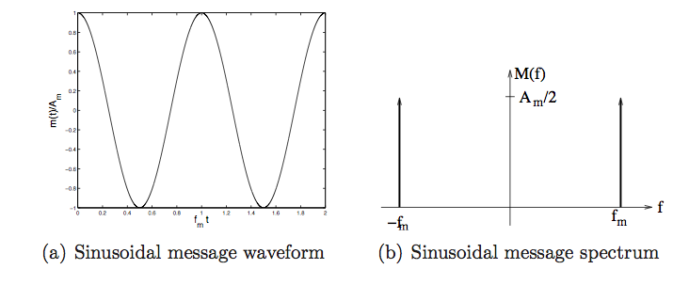
Running example: sinusoidal message

Slide 10
Amplitude Modulation

Slide 11
Amplitude modulation
DSB: encode info in I component
Uses twice the bandwidth it really needs
Requires carrier sync for demodulation
Conventional AM
Modifies DSB to eliminate carrier sync requirement at the expense of power efficiency
SSB/VSB
More efficient bandwidth usage than DSB
Requires carrier sync for demodulation
Can be modified to eliminate carrier sync requirement at the expense of power efficiency

Slide 12
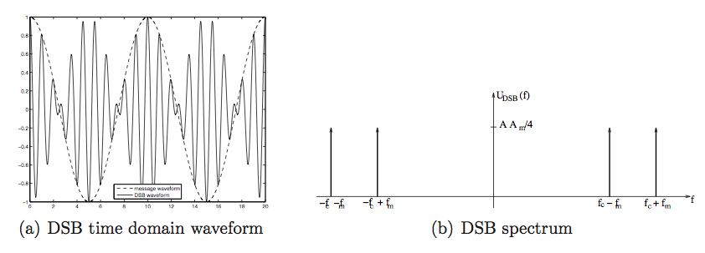
DSB signal for sinusoidal message

Slide 13
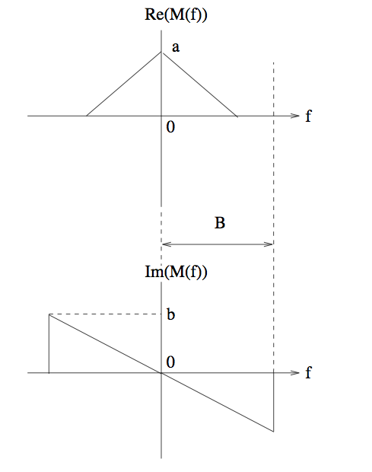
A more interesting example message

Slide 14
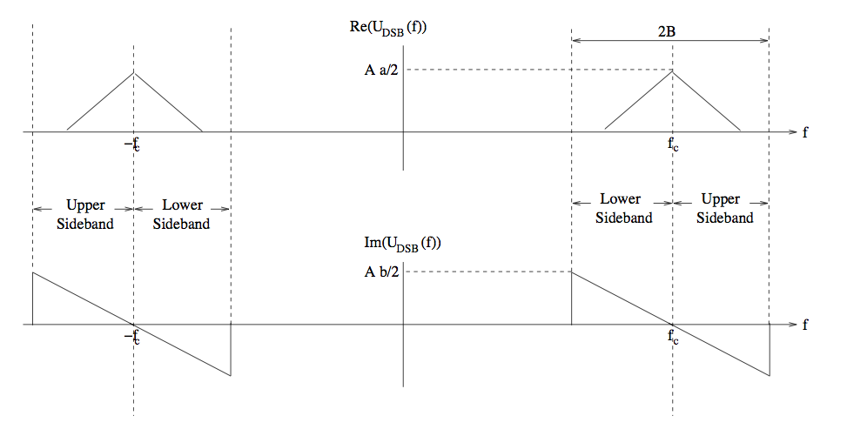
DSB spectrum

Slide 15
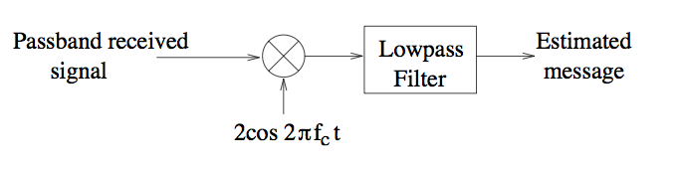



Demodulation of DSB-SC
Standard downconverter to recover I component
Requires carrier sync
Carrier phase offset ➔ Message attenuation at output
Passband received signal, with
phase offset wrt local carrier at RX
Complex envelope with respect to RX carrier
I component extracted by downconverter
(message gets attenuated due to phase offset)

Slide 16
Sidestepping sync requirement
The envelope (or magnitude of complex envelope) does not depend on carrier phase
Suppose we can extract the envelope of a passband signal (will soon see a simple circuit for this purpose)
Does not require carrier sync
Can we recover the message?

Slide 17
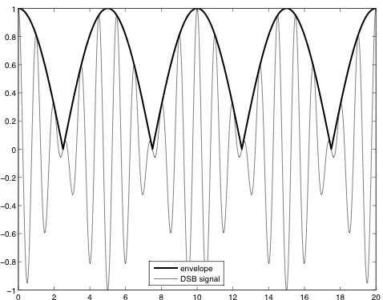
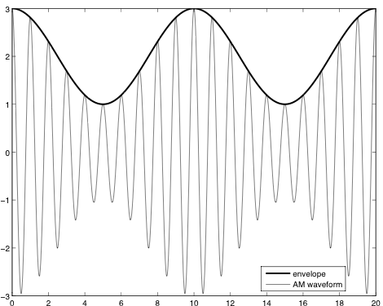
What does the envelope tell us?
Example: sinusoidal message waveform
DSB signal
Envelope = message magnitude
➔ Envelope detection loses info
in message sign
DSB signal + strong carrier component
Envelope = message + DC
Envelope detector + DC block
recovers message info

Slide 18
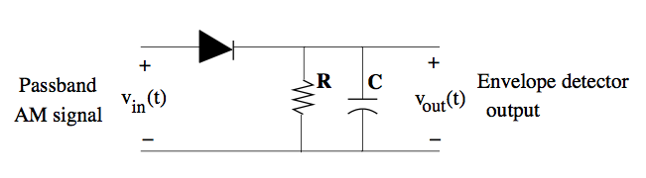
How do we do envelope detection?
Positive carrier cycle ➔ capacitor charges up (reaches value of envelope)
Negative carrier cycle ➔ capacitor discharges with RC time constant

Slide 19
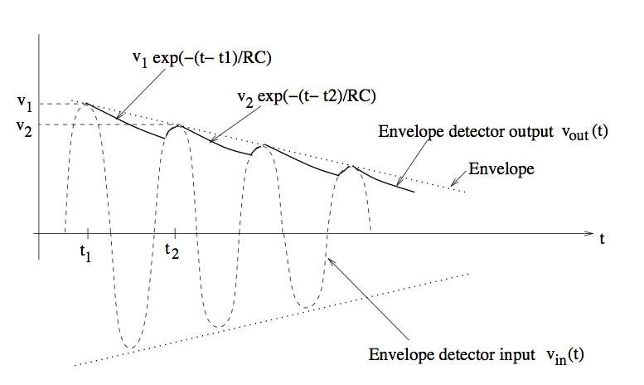
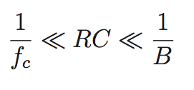
Envelope detector operation
Positive carrier cycle ➔ capacitor charges up (reaches value of envelope)
Negative carrier cycle ➔ capacitor discharges with RC time constant
Should not discharge too fast during negative cycle
Should react fast enough to follow variations in envelope
(which depend on message bandwidth B)

Slide 20
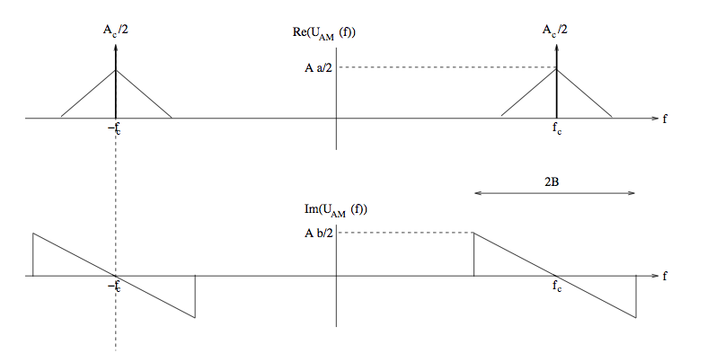
Conventional AM: spectrum
Strong carrier component

Slide 21




Conventional AM
Add strong carrier component
to DSB signal
AM spectrum
Envelope of AM signal
Condition needed for envelope to preserve message info
Can be expressed in terms of modulation index
Should be smaller than one

Slide 22
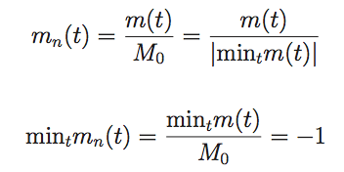

AM signal in terms of modulation index
Convenient to normalize message so largest negative swing is -1
AM signal expressed in terms of modulation index and normalized message

Slide 23
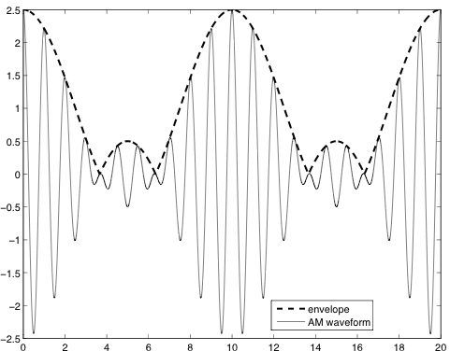
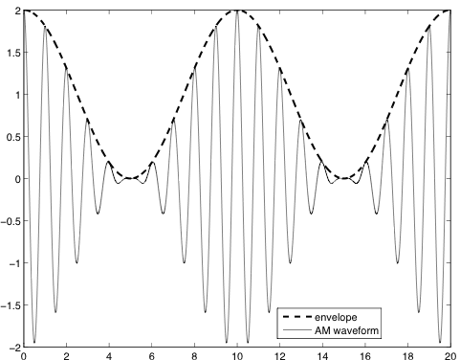
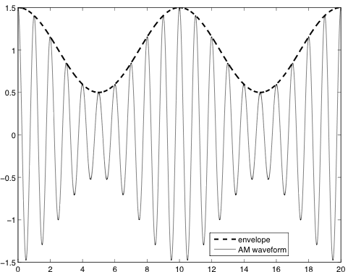
Effect of modulation index
Example of sinusoidal message
Envelope = message + DC
Envelope = message
Message info not preserved
in envelope

Slide 24





Power efficiency
Power of AM signal
0 (DC component of
passband signal at 2f_{c}
Power of message bearing component of AM signal
Power efficiency

Slide 25
Example power efficiency computation
Find normalized message and its power (the larger the message dynamic range, the less
the power of the normalized message)
Modulation index 70%
Power efficiency?
Need to find minimum of message and then normalize by its magnitude to get m_{n}
Suffices to minimize
Can minimize numerically (over a period) or analytically to get
➔

Slide 26

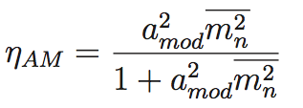
Power efficiency computation (contd)
=0.24 for a_{mod}=0.7

Slide 27
DSB ➔ SSB
Message signal
DSB signal

Slide 28
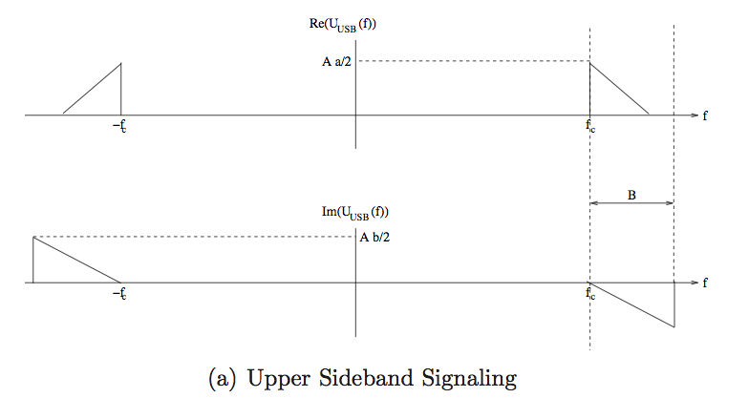
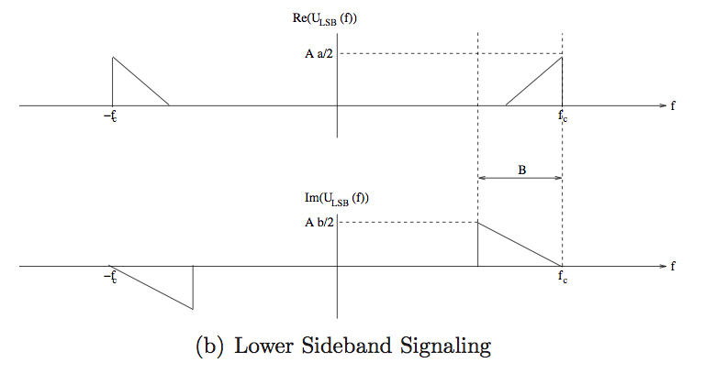
Single sideband (SSB)
Each sideband
has enough
info to reconstruct
the message
(Move in by f_{c}➔
extract I component)
Message is the I component of an SSB signal.
What is the Q component?

Slide 29
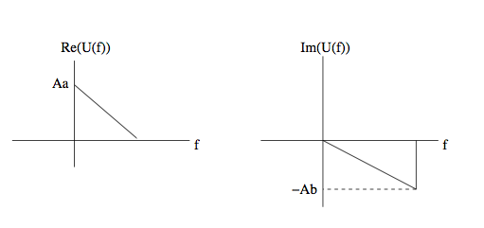
Complex envelope for SSB signal
USB passband
USB complex envelope

Slide 30
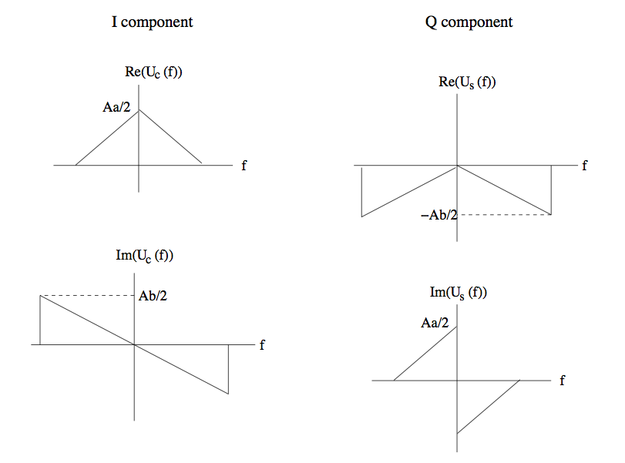
I and Q components for SSB
USB complex envelope
USB I and Q components

Slide 31


Hilbert transform
(90 degree phase shift over all positive frequencies)

